Slide 1
Friday 27th March 2020
Fourth Class Green
Home Learning Activities

Slide 2
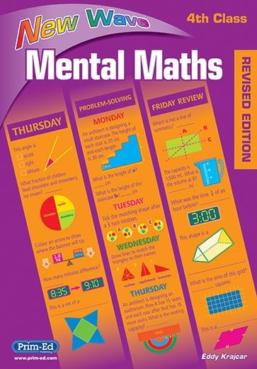
Mental Maths

Slide 3
Maths
Decimals
https://ie.ixl.com/math/class-4/what-decimal-number-is-illustrated
https://ie.ixl.com/math/class-4/place-values-in-decimal-numbers

Slide 4
Friday Quiz
https://www.seomraranga.com/2020/03/stay-at-home-quiz-1/

Slide 5
History: The Great Famine
http://www.askaboutireland.ie/learning-zone/primary-students/1st-+-2nd-class/history/history-the-full-story/ireland-in-the-19th-centu/government-reaction/
https://www.scoilnet.ie/go-to-primary/theme-pages/history/famine/

