Slide 1
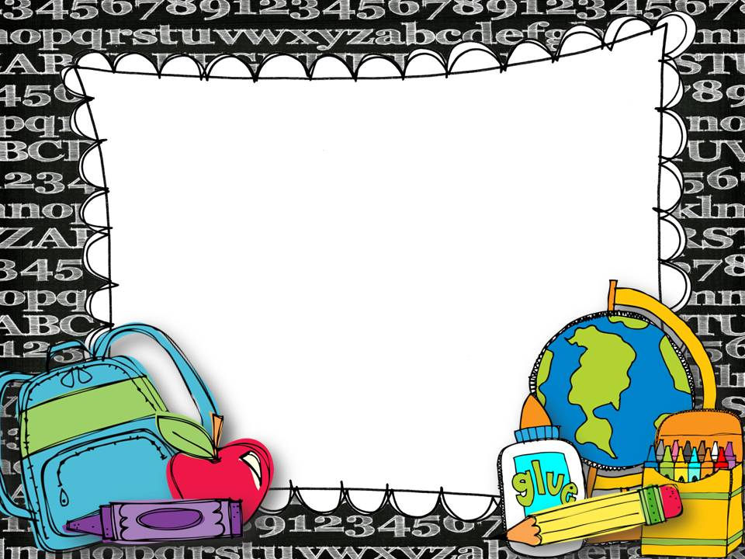
Thursday 2nd April 2020
Home Learning Activities
Fourth Class Green
Teacher: Sarah

Slide 2
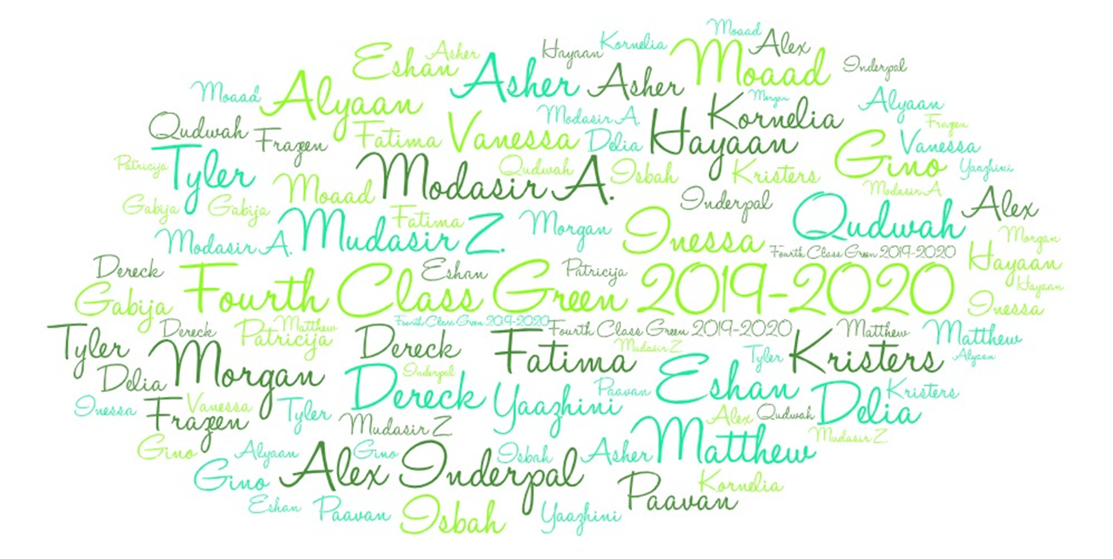

Slide 3
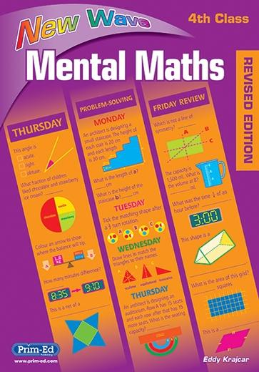
Mental Maths

Slide 4
P.E.

Slide 5
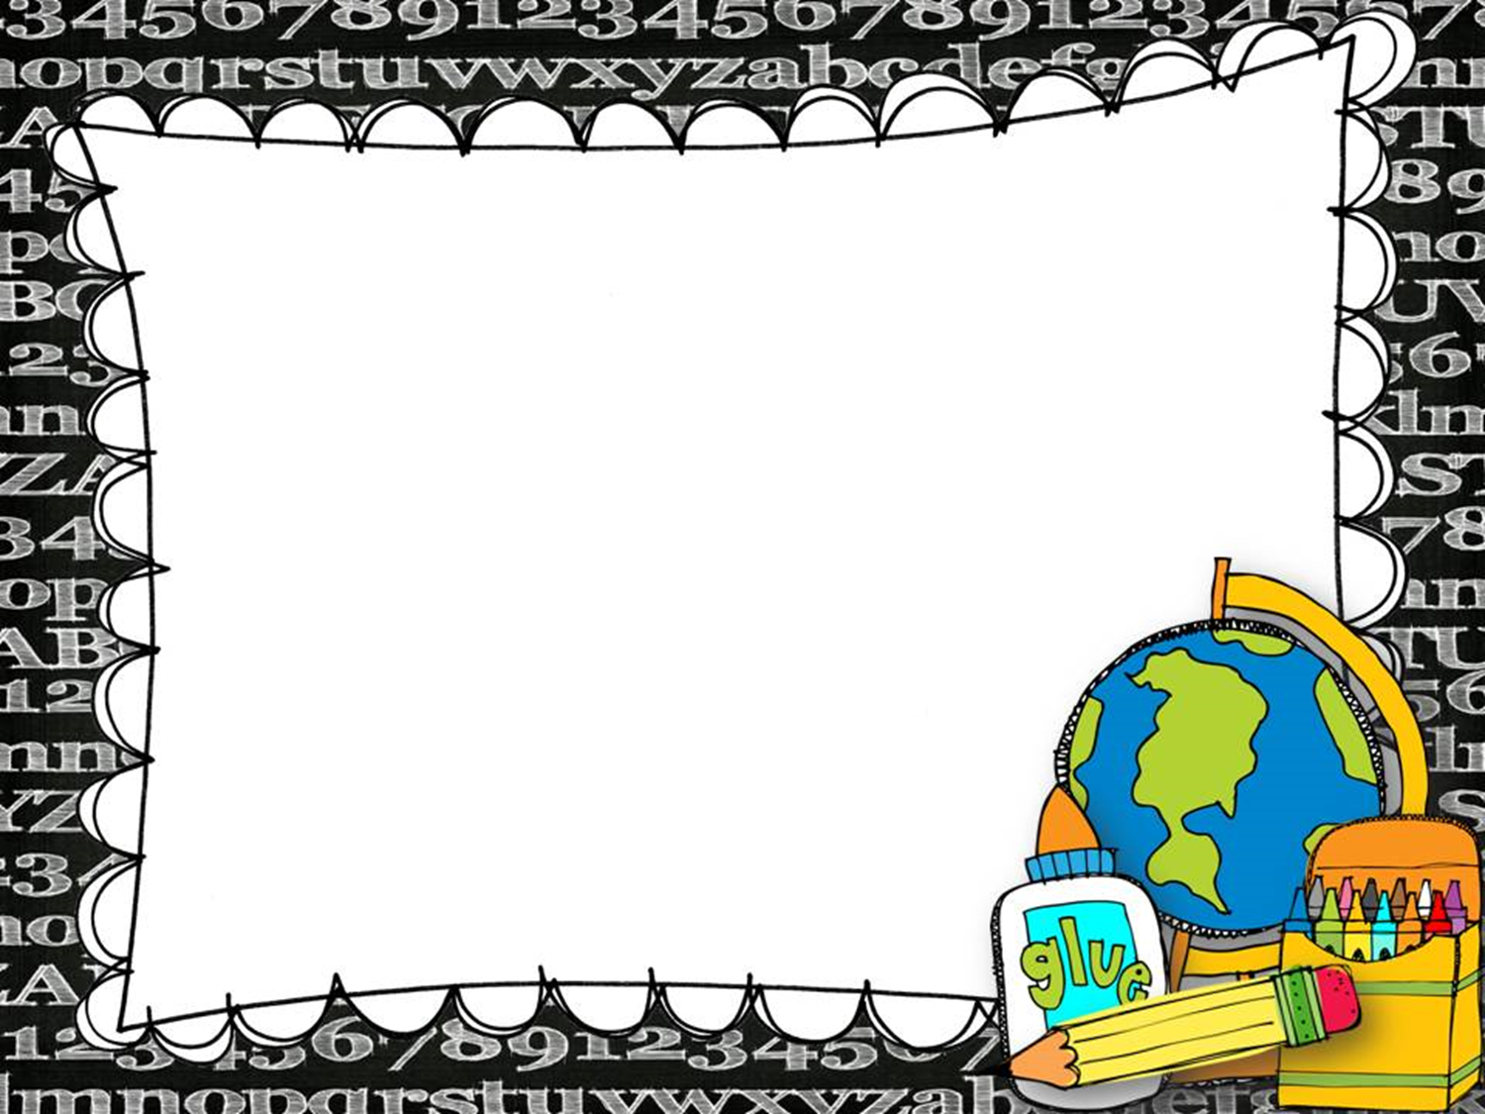
Circle Time: Who am I?

Slide 6
Maths Drill
https://www.online-stopwatch.com/full-screen-stopwatch/
https://www.timestables.com/

Slide 7
Problem Solving
Problem 1:
A bottle holds half a litre of water. How many bottles of water could a 3 litre jug fill?
Problem 2:
Zara sends out 40 invitations. ¾ of the people she invites reply saying they can go. How many people can’t go?
Problem 3:
A new game cost €8. Alfie receives 50c spending money a week.
How many weeks will it take him to save up for the game?

Slide 8
Problem Solving
Problem 4:
Ruby has 31 marbles. Dan has twice as many marbles as Ruby. How many marbles has Dan got?
Problem 5:
Luke has 58 marbles. Jade has half as many marbles as Luke. How many marbles has Jade got?
Problem 6:
Leon has a cake mix. For every 100g of mix he uses, he must
add one egg and 30 mls of water.
He uses 300g of mix. How much water must he add?

Slide 9
Operation Maths Pupil’s Book pg. 100-101

Slide 10
The Magician’s Nephew: Chapter 4

Slide 11
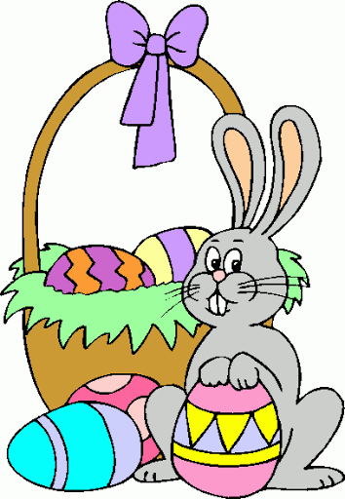
The Mystery of the Easter Egg Eater Clue 4

Slide 12
English: Spellings for Me
15 minutes
https://school.spellingsforme.ie/account/login

Slide 13
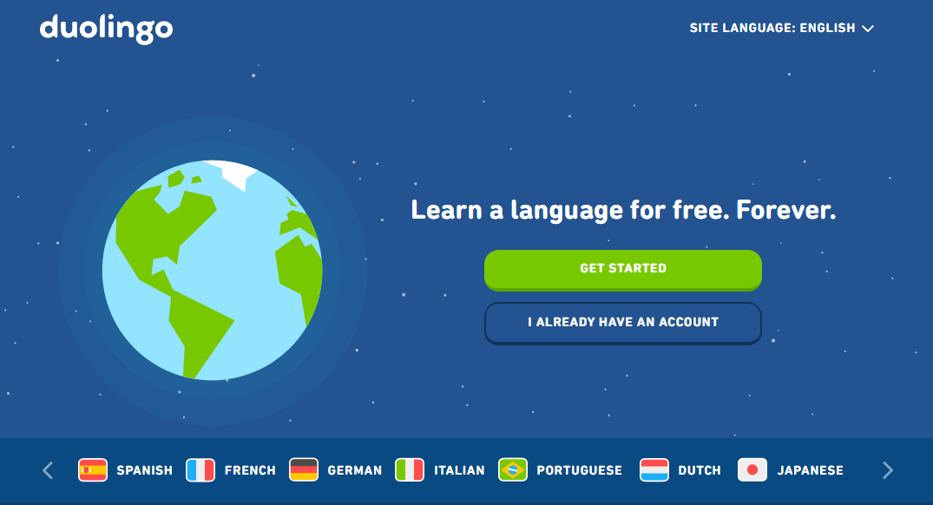
Gaeilge: Duo Lingo
15 minutes
https://www.duolingo.com/

Slide 14
Gaeilge: An Cluiche Ríomhaire Nua

Slide 15
Learn Together

Slide 16
Dabbledoo: Lesson 12 –The Bare Necessities
Link to Full Lesson Content Here

Slide 17
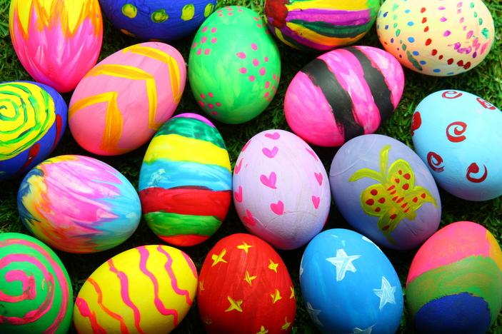
Art: Painting Easter Eggs

Slide 18
Geography: Chapter 10: Potatoes

Slide 19
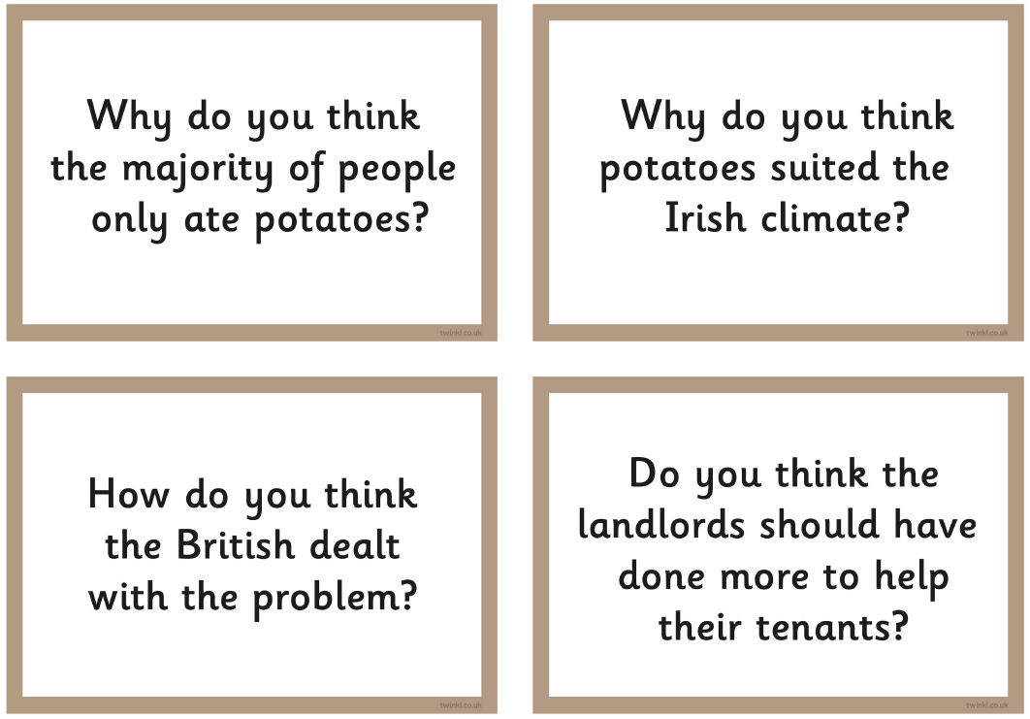
History: The Famine Discussion Cards

Slide 20
RTE: Home School Hub
RTE Home School Hub Link to Player

Slide 21
Well Done for all your hard work today!
Have a lovely afternoon everybody! Slán libh!
See you tomorrow!

